Slide 1
WMD Industrial Technology
WMD Industrial Technology（Xiamen) Co., Ltd.
维美德工业技术(厦门）有限公司

Slide 2
WMD Industrial Technology
About us
WMD Industrial Technology (Xiamen) Co., Ltd. is a high-tech innovative company, integrating to design, R&D and manufacturing. We typically involve in hydraulic machine or equipment, WMD also has capability of design and develop the control system in independently, include MCU software and electrical hardware control module accordingly, providing professional customized services to customers.
WMD have two glittering produce- WMD form machine and high-quality power packs, our form machine has very good reputation with stable and high efficiency. Our power pack massively use on garbage stations and sanitation equipment.
Our hydraulic engineers looked at the specification and established to refurbished and designed a more efficient and ever-improving technology HPU system。
WMD are working with our customers to provide an uncompromised, cost-effective and sustainable solution, aim to continuously add value to our clients businesses, and build a strong relationship that last.

Slide 3
WMD Industrial Technology
1. WMD Forming Technology
维美德工业----管端成型技术

Slide 4
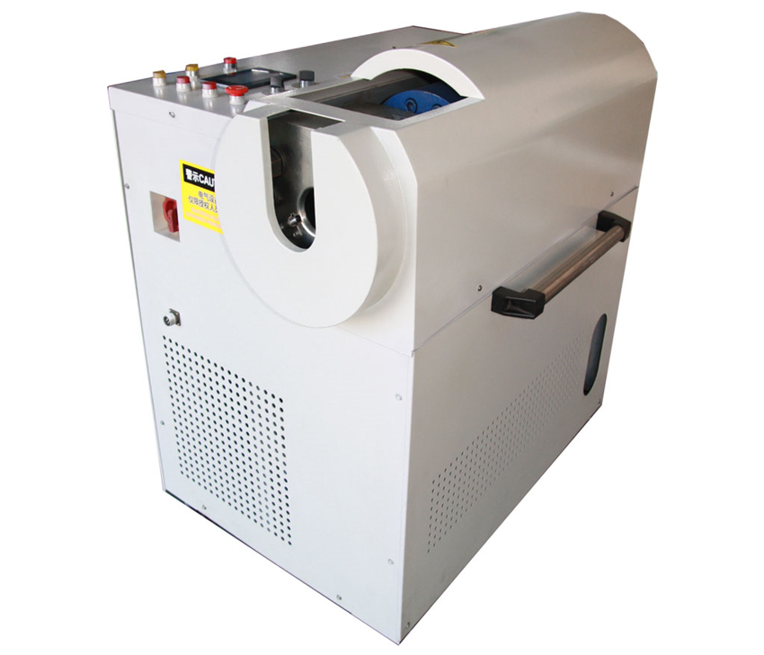
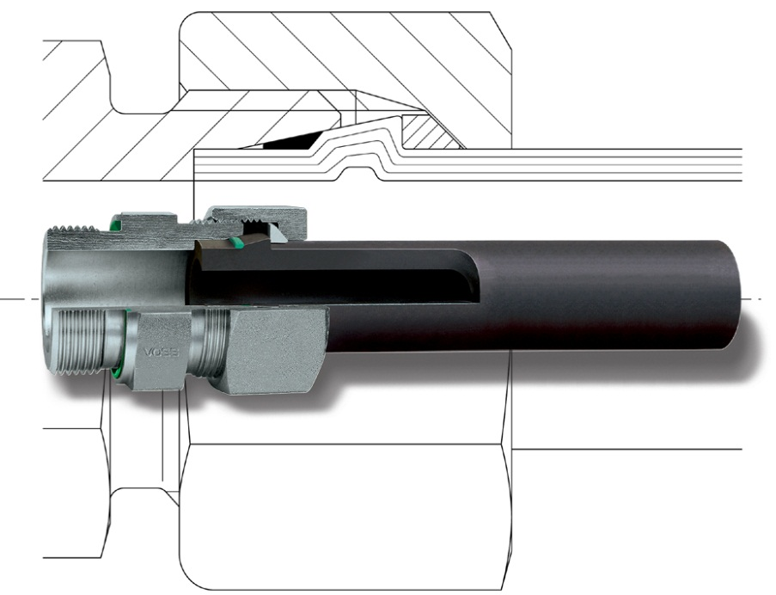
WMD forming machine 管端成型机
WMD Industrial Technology

Slide 5

WMD Industrial Technology
WMD forming tube connection solution
24°conical surface
FKM seal
Double seal-FKM seal slot and 24°conical surface seal created in same place
Absorb vibration-C-type locked ring clamping pipe, absorb any vibration, avoid loose
High efficiency- one time forging, no per-install, no welding, no need second process
Economy-localization batch production, low cost.
C-type locked ring

Slide 6
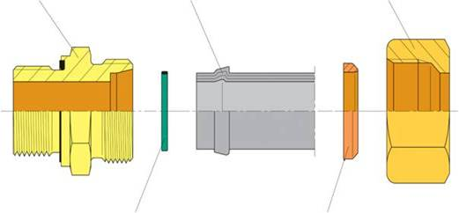
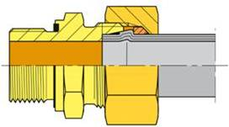
WMD Industrial Technology
WMD forming tube connection solution
Standard fittings
Formed tube end
FKM Seal ring
Standard din nut with C-type Locked ring
Standard connecting piece according to DIN 3861/ ISO 8434-1 标准接头
Standard nut according to DIN 3870/ISO 8434-1 标准螺母
Formed tube end 成型管端
Sealing ring of FPM / FKM 氟橡胶密封圈
Clamping ring (pressed into nut) 锁紧环 （压 入螺母中）
A simple & high reliable connection system created

Slide 7
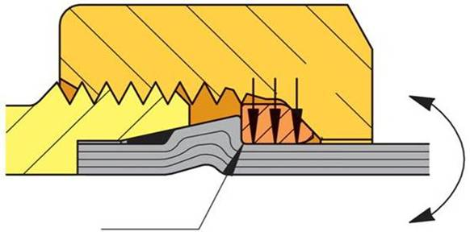
WMD Industrial Technology
WMD forming system -Absorption of dynamic loads
All dynamic loads change to vertical pressure of tube, avoid damage of connection system
Fixation of the tube with integrated c-type locked ring, reduced notch sensitivity
M_{b}
Absorption of dynamic loads by integrated clamping ring 集中锁紧环吸收动态载荷

Slide 8
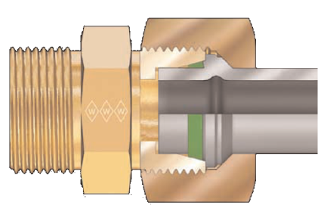
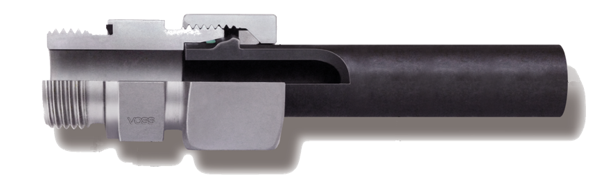


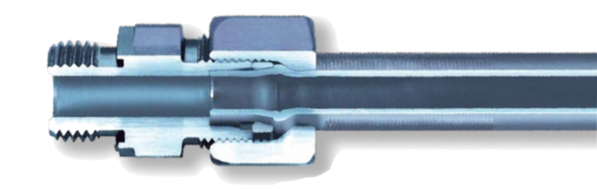

WMD Industrial Technology
Comparison of features /特征与性能对比
WMD
Sealing concept 密封理念
Tube fixing 管子固定
Function of clamping ring 锁紧环功能
Forming machine / process 成型机器及程序

Slide 9
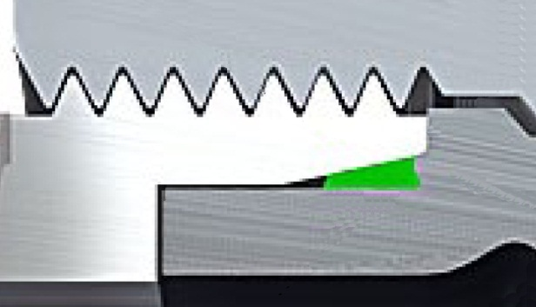
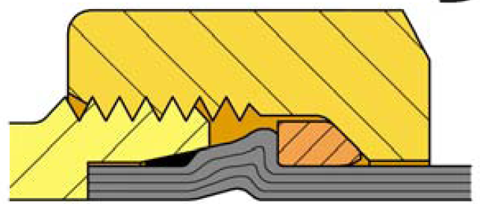
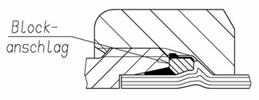
WMD Industrial Technology
Sealing area in tube end stop position 管端密封区域
Only soft-seal inside 仅有软密封
Gap between tube and connecting piece ground 管端与接头底端有间隙
Pressure shocks reach directly on soft-seal 压力脉冲直接作用于软密封处
Two quasi-static sealing concept 静密封，24度锥硬密封+软密封
Primary static 24 conical metal surface seal 24度锥金属硬密封面为主密封
FKM seal avoid seepage leakage 胶圈防止渗漏
Absorbability of pressure shocks on soft-seal 吸收了软密封处的压力脉冲
Gap extrusion of soft-seal inside the system excluded管端与接头底端无间隙
软密封不会通过间隙挤出
WMD

Slide 10

WMD Industrial Technology
Pressure variations in the field of the elastomer
密封处的压力脉冲
WMD
500
Pressure variations in hydraulic systems 液压系统中的压力脉冲
500
Pressure variations in hydraulic systems 液压系统中的压力脉冲
[bar]
Pressure variations in front of the seal 密封处的压力脉冲
[bar]
Pressure variations in front of the seal 密封处的压力脉冲
375
375
250
250
125
125

Slide 11
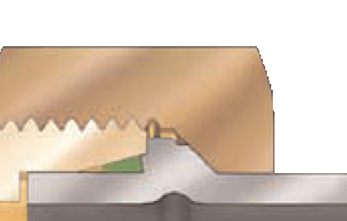
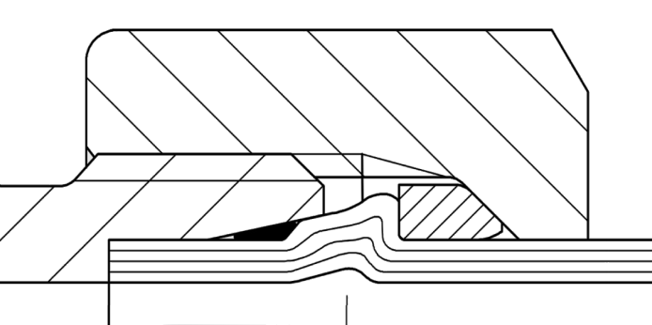
WMD Industrial Technology
Surface pressure in the metallic-sealing area 金属密封区域的接触压力
Low surface pressure in the metallic-sealing area F_{sp}~ F_{m} 金属密封区域接触压力低
Because of the subsequently initiated contour modification (Walformplus) the problem of tube-rotation was going to be reduced WalForm 的接触面改进后降低了管子跟转问题
High surface pressure in the metallic-sealing area ~ 4,8 F_{m} 金属密封区域的接触压力高
No rotating of the tube 管子不会跟转
Compensation against settling phenomenon caused by tension of 24° cone 塑性变形补偿
°
F_{Sp} = F_{m} / sin12°
~4,8 F_{m}
F_{sp}~ F_{m}
12
°
12
F_{sp}
F_{m}

Slide 12

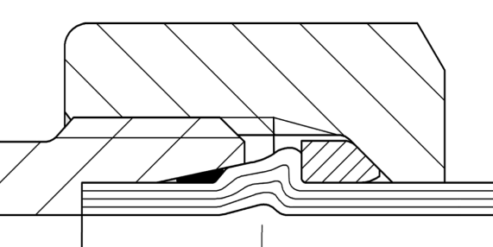

WMD Industrial Technology
Fixing of tube in the coupling 在接头中固定钢管
Radial fixing because of slotted clamping ring 锁紧环径向锁紧钢管
Absorption of bending fatigue stress in front of the formed section 在钢管变形处前段吸收弯曲应力
Reduction of notch effect because of radius in the clamping ring 因锁紧环，降低了变形处的应力集中
WMD
Fixing at the bevel part of the contour 成型面锁紧钢管
Bending fatigue stresses are stopped directly in the formed section 弯曲应力直接作用在钢管变形处
Notch effect 应力集中在变形处
M_{b}
M_{b}
M_{b}

Slide 13
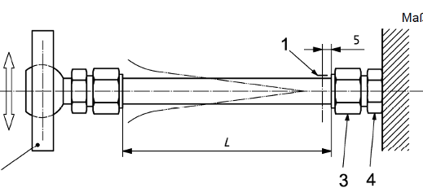
WMD Industrial Technology
Comparison of bending fatigue strength 交变弯曲强度对比
M_{b}
M_{b}
Size | WMD FORM 维美德成型 | Walform 万特塞成型 | Improvement to Walform 提高比例
L 18x2 | 130 N/mm² | 110 N/mm² | 18%
L 30x3 | 130 N/mm² | 110 N/mm² | 18%
S 38x5 | 140 N/mm² | 100 N/mm² | 40%
L 42x3 | 110 N/mm² | 100 N/mm² | 10%
DIN EN ISO 19879

Slide 14
WMD Industrial Technology
WMD FORM machine 管端成型机
一键成型，成型步骤自动完成 Automated process steps by light beam
成型完成自动退回插入位置，适合连续作业Automatically change from removal to insert position
具有手动或自动模式选择，更好适应作业工况 Manual or auto model
多档管子外径选择开关，对应最佳成型程序 Range selection of tube size for optimal forming process
更换模具夹具简单，不需要额外工具，半分钟换模Change of forming head and clamping jaws without additional tools
更短的成型时间 Short positioning times
  6-10 mm < 10 sec.
  12-22 mm < 15 sec.
  25-42 mm < 20 sec.

Slide 15
WMD Industrial Technology
WMD FORM machine 管端成型机
远程协助，远程诊断，通过物联网技术，专业人员进行远程协助，远程设备诊断， 提供高效服务。
Remote assistant, remote diagnose via IOT with high efficient service.

Slide 16
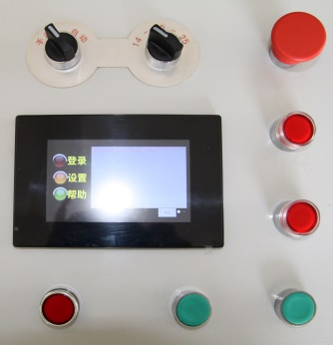
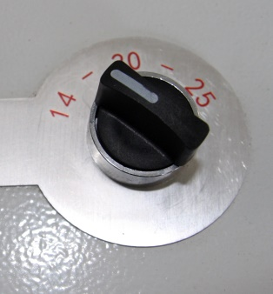
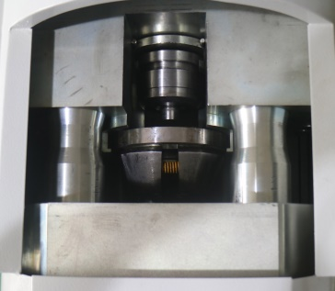
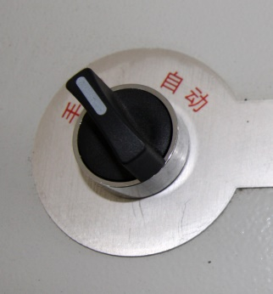
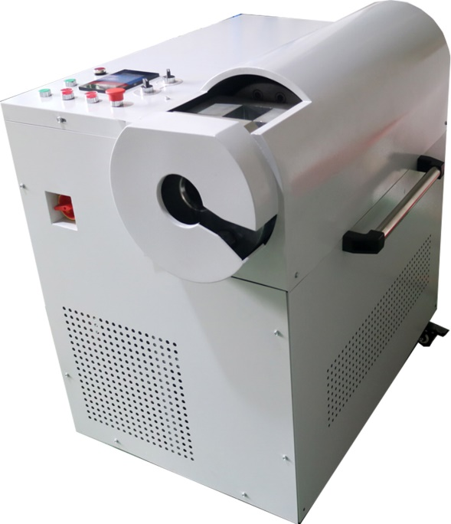
WMD Industrial Technology
User-friendly design 操作简单
Range of Tube Size selection 多档位管径选择，对应不同成型程序。
Improved ergonomics and user-friendliness by rearrangement of the operator keys
人体工程学按键设计，操作方便
Changing head and jaws without tools
更换模具夹具不需要工具，半分钟换模
Manual or Auto model 手动/自动模式适应不同作业工况。
Castors with PU wheels for convenient transportation 滚轮方便运输
One Key power on/off
一键电源开关

Slide 17
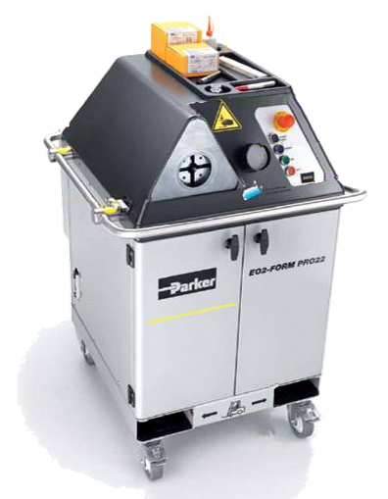

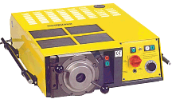
WMD Industrial Technology
Comparison of installation-friendliness 设备简尺寸
Complete machining centre BxHxT 700x900x1000
Complete machining centre BxHxT 900x1122x943
Tabletop unit – weight 220 kg No possibility for tool tray BxHxT 1000x260x850

Slide 18
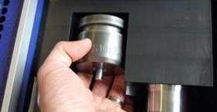
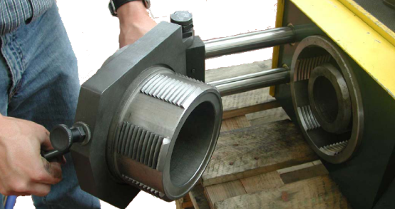
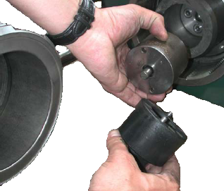
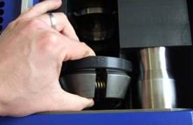
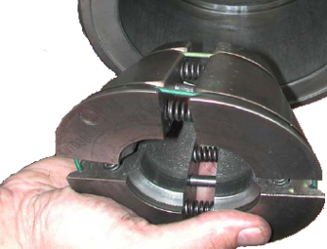
WMD Industrial Technology
Changing of forming tools 模具更换
WMD
Forming head (Changing without tools) 模具更换不需要工具
Forming head (Changing with tools) 模具更换需要工具
Clamping jaws (Changing without tools) 夹抓更换不需要工具
Clamping jaws (Changing with tools) 夹抓更换需要工具

Slide 19
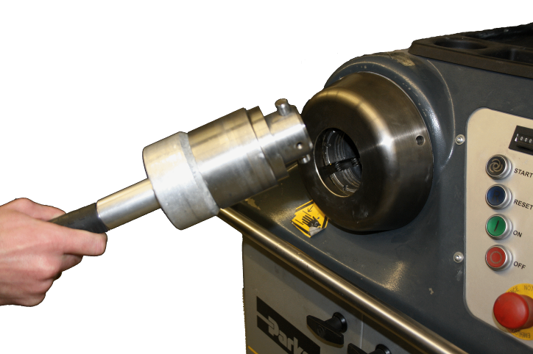

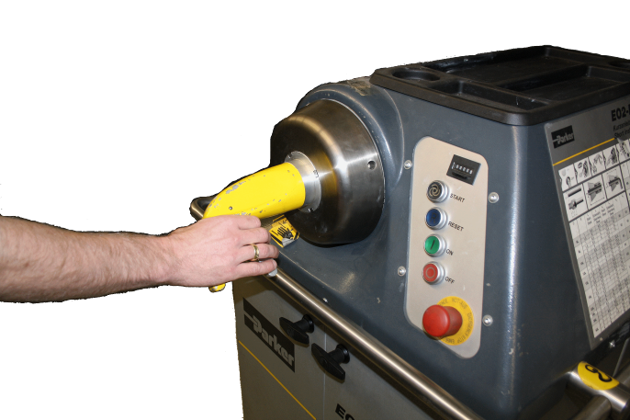
WMD Industrial Technology
Changing of forming tools 模具更换
WMD
Forming head (Changing without tools) 模具更换不需要工具
Forming head (Changing with tools) 模具更换需要工具
Clamping jaws (Changing without tools) 夹抓更换不需要工具
Clamping jaws (Changing with tools) 夹抓更换需要工具

Slide 20
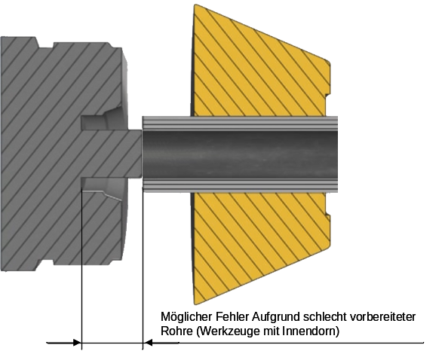
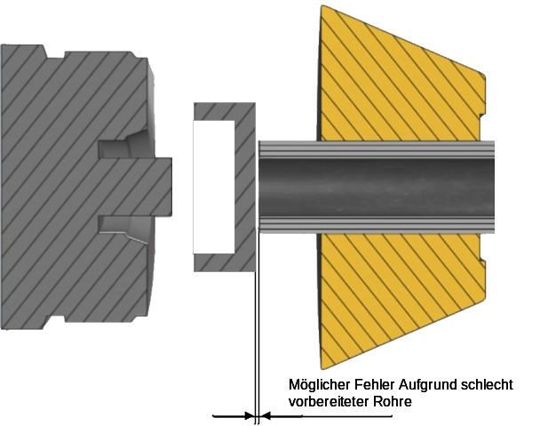
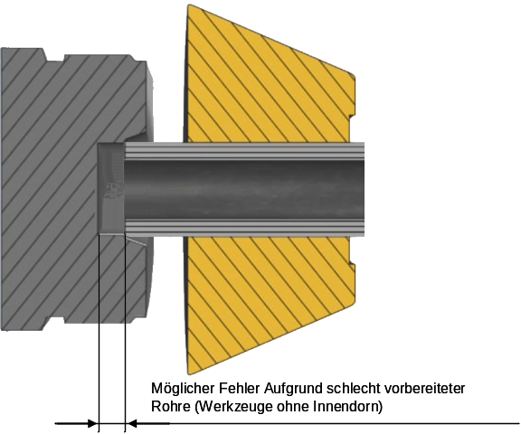
WMD Industrial Technology
Consequence of bad tube preparation 钢管成型缺陷风险
WMD
Stop Plate
Possible mistake because of bad prepared tubes insert edlength（没有定位） 成型缺陷大
Possible mistake because of bad prepared tubes inserted length 因为有挡板，定位精准，具有导向芯，防止偏心，即使管端未处理好，也最大限度的降低的成型缺陷
WMD: Minimization of mistake by stop plate and inner mandrel
维美德： 因挡板和导向芯，最大限度的降低了成型缺陷
Possible mistake because of bad prepared tubes (Tool without inner mandrel) insert length 成型缺陷大，而且没有轴芯保障

Slide 21
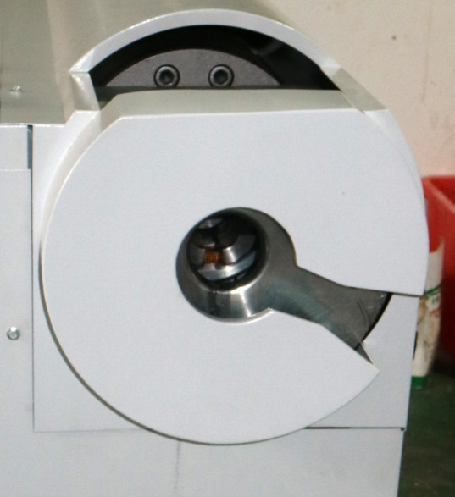
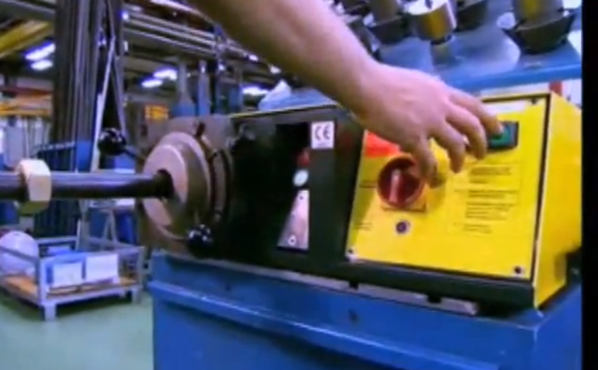
WMD Industrial Technology
Forming process 成型过程
Defined insert position with stop plate 通过挡板确保钢管插入深度，定位准确
Choice of optimal forming process 根据管子外径可选择最佳成型程序
Manual or Auto model 具有手动和自动模式，更方便作业
Forming process starts with a singular pushing of the start button，or waiting 2 second and go to next process. 按单个按钮完成成型过程，或自动模式下等待2秒，自动完成成型过程
Insert position without stop plate 钢管插入位置无挡板定位
Machine must be operated manually to reach the insert position before removing the part (two-hand operating) 机器先要手动推进到插入位置才能开始成型

Slide 22

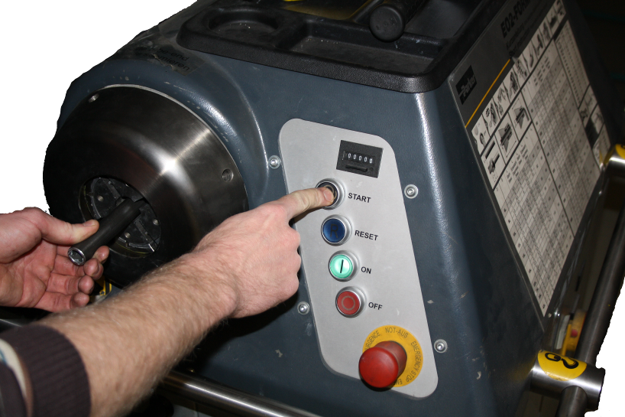
WMD Industrial Technology
Forming process成型过程
Defined insert position with stop plate通过挡板确保钢管插入深度，定位准确
Choice of optimal forming process 根据管子外径可选择最佳成型程序
Manual or Auto model 具有手动和自动模式，更方便作业
Forming process starts with a singular pushing of the start button，or waiting 2 second and go to next process. 按单个按钮完成成型过程，或自动模式下等待2秒，自动完成成型过程
Start button has to be pressed during the whole forming process 在成型过程中，要始终按住开始按钮
Only one position for insert and removal of the tube (lack of process reliability) 插入和成型都在一个位置（影响过程稳定性）
(By rotation of tube the forming head can become unscrewed 随着管子转动，模具会松动)

Slide 23
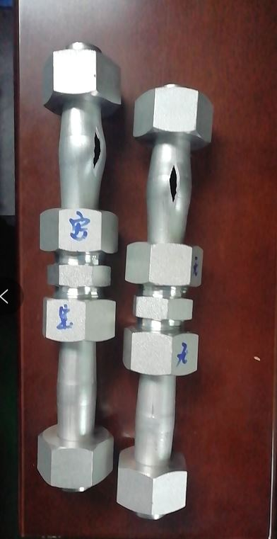
WMD Industrial Technology
Broken comparison
testing-With/Without
FKM sealing ring
加与不加密封圈对比测试
Tube type钢管型号:
25X2.5mm
Fitting 接头：S25
Pressure : 1011bar, Tube broking钢管爆裂
Same result, with/without FKM seal ring 加与不加密封圈
The connection system perfect 连接处密封零泄漏

Slide 24
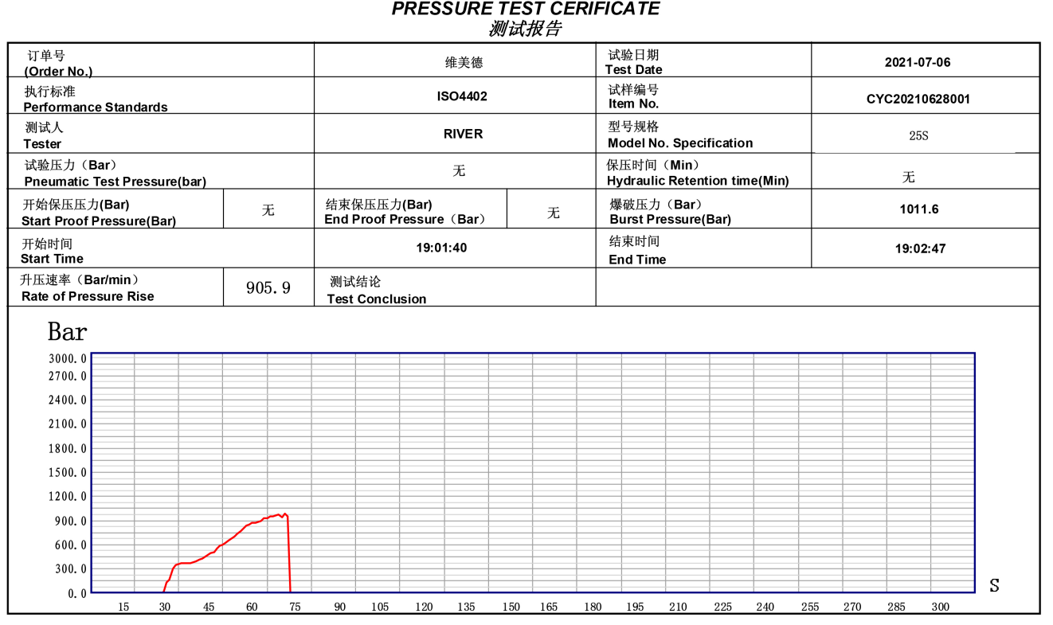
WMD Industrial Technology
Broken comparison testing-With/Without
FKM sealing ring加与不加密封圈对比测试-without FKM seal

Slide 25
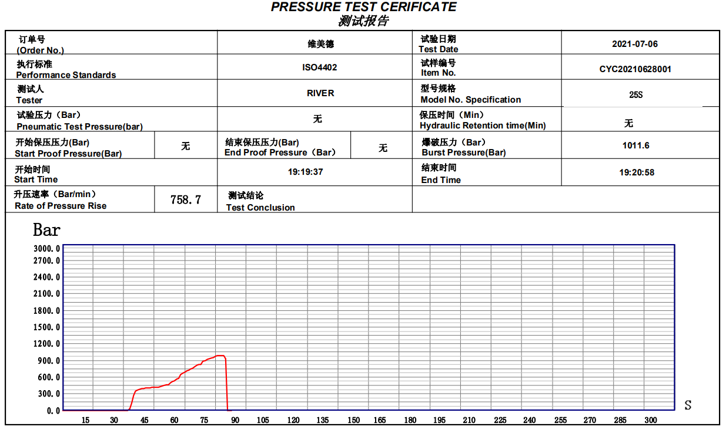
WMD Industrial Technology
Broken comparison testing-With/Without
FKM sealing ring加与不加密封圈对比测试-with FKM seal

Slide 26
WMD Industrial Technology
1.2 WMD Forming machine 306
维美德钢管成型机 306
WMD Forming machine 306 adopt tow hydraulic system, one hydraulic pressure are 63Mpa, another is 6Mpa, the Ultrahigh pressure was created by piston pump directly, low pressure was created by gear pump, pump and ultrahigh pressure valve are import from Germany brand of HAVE , more efficiency and more quiet.
维美德成型机 306是采用双线路液压系统，高压工作压力63Mpa, 低压工作压力6Mpa, 高压由超高压柱塞直接产生，低压油齿轮泵产生，泵和高压阀都采用德国进口品牌哈威的产品，更高效，更安静。

Slide 27
WMD Industrial Technology
WMD Forming Machine 306 Configuration
# | Name | Mode | Origin
1 | Servo Motor | VeiChi | China/VEICHI
2 | Pump1 | RZ2.1/2-28 | Germany/HAWE
3 | Pump2 | RZ2.1/2-28 | Germany/HAWE
4 | Oil Circuit Block | YU-306 | Local
5 | Valve1 | 24V多款 | Germany/HAWE
6 | Valve2 | 24V多款 | China
7 | Cylinder1 | 150/70-63/6 | Local
8 | Cylinder2 | ROB-25-60 | Local
9 | Radiator | AH1012 | China
10 | Main board | STM32F407 | STM
11 | Screen | 5X | China
12 | Pressure sensor | LVC-1000 | Winters
13 | Sensor | TB0802N | China
15 | Switch | 多款 | China

Slide 28
WMD Industrial Technology
1.3 WMD Forming machine 308
维美德钢管成型机 308
WMD Forming machine 308 adopt tow hydraulic system, one hydraulic pressure are 63Mpa, another is 6Mpa, the Ultrahigh pressure include interior and exterior two oil ways, gear pump create 18.5Mpa pressure in exterior way, and interior 63Mpa created with two boosters, all valve are working in low pressure of 18.5Mpa and 6Mpa, improve the system stability and extend the life of machine.
维美德成型机 308是采用双线路液压系统，高压工作压力63Mpa, 低压工作压力6Mpa, 高压由内外两层液压油路组成，外围工作液压由齿轮泵产生18.5Mpa压力, 内围由高性能增压器产成超高工作压力，实现将机械动作频繁的阀块工作在较低压力环境下，提升系统稳定性，延长使用寿命。

Slide 29
WMD Industrial Technology
WMD Forming Machine 308 Configuration
# | Name | Mode | Origin
1 | Motor | 三相卧式5.5HP-4P | Taiwan
2 | Pump1 | 50T 7Mpa, 20cc/r | Taiwan
3 | Pump2 | HGP-2A-F6R | Taiwan
4 | Oil Circuit Block | 4路，4路 | Local
5 | Valve | 24V多款 | Huade
6 | Cylinder1 | 150/70-63/6 | Local
7 | Cylinder2 | ROB-25-60 | Local
8 | Booster | BSY-3.4T | Deshihong
9 | Radiator | AH1012 | China
10 | Main board | STM32F407 | STM
11 | Screen | 5X | China
12 | Pressure sensor | LVC-1000 | Winters
13 | Sensor | TB0802N | China
15 | Switch | 多款 | China

Slide 30
WMD Industrial Technology
1.4 WMD Forming machine 60
维美德钢管成型机 60
WMD Forming machine 60 adopt one hydraulic system, hydraulic pressure are 28Mpa, all valve are working in low pressure of 28Mpa improve the system stability and extend the life of machine.
维美德成型机 60是采用单线路液压系统，高压工作压力28Mpa, 实现将机械动作频繁的阀块工作在较低压力环境下，提升系统稳定性，延长使用寿命。

Slide 31
WMD Industrial Technology
WMD Forming Machine 60 Configuration
# | Name | Mode | Origin
1 | Servo Motor | Veichi | China
2 | Pump2 | HGP-2A-F6R | Local
3 | Oil Circuit Block | 4路 | Local
4 | Valve | 24V多款 | Huade
5 | Cylinder1 | 150/70-63/6 | Local
6 | Cylinder2 | ROB-25-60 | Local
7 | Radiator | AH1012 | China
8 | Main board | STM32F407 | STM
9 | Screen | 5X | China
10 | Pressure sensor | LVC-1000 | Winters
11 | Sensor | TB0802N | China
12 | Switch | 多款 | China

Slide 32
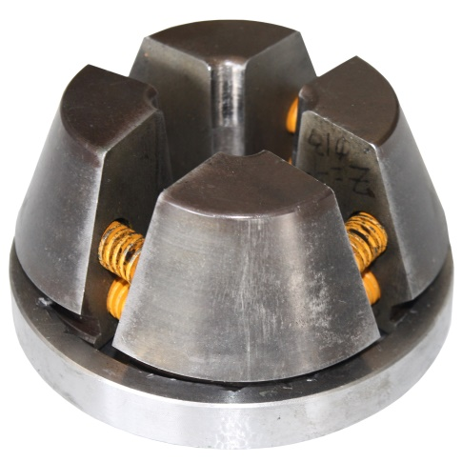
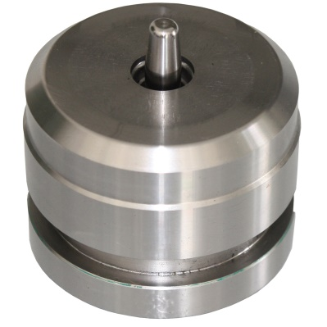
WMD Industrial Technology
1.5 Clamper & die
模具和夹具
Clamper and die is using for WMD forming machine, each type of clamper apply for each diameter of pipe, each type of die should apply for each diameter and thick of pipe, using wrong die and clamper will cause damage , or forged improperly.
该模具和夹具是维美德钢管成型机专用配件，针对不同管径，不同壁厚钢管配合使用，同一管径的钢管可以用同款夹具，不同壁厚的钢管应使用对应的模具，以达到最佳成型效果，错用模具，将造成事故或无法成型。

Slide 33
WMD Industrial Technology
Clamper & Die 夹具和模具-1
# | S/N | Item Name | Description
2 | C-L8 | Clamp L8 | Clamp for pipe diameter of 8mm
 | M-L8X1.0 | die L8X1.0 | Light type die for pipe diameter of 8mm, thick of 1.0mm
 | M-S8X2.0 | die S8X2.0 | Heavy type die for pipe diameter of 8mm, thick of 2.0mm
3 | C-L10 | Clamp L10 | Clamp for pipe diameter of 10mm
 | M-L10X1.5 | die L8X1.5 | Light type die for pipe diameter of 10mm, thick of 1.5mm
 | M-S10X2.0 | die S10X2.0 | Heavy type die for pipe diameter of 10mm, thick of 2.0mm
4 | C-L12 | Clamp L12 | Clamp for pipe diameter of 12mm
 | M-L12X2 | die L12X2.0 | Light type die for pipe diameter of 12mm, thick of 2.0mm
 | M-S12X2.0 | die S12X2.0 | Heavy type die for pipe diameter of 12mm, thick of 2.0mm
5 | C-S14 | Clamp S14 | Clamp for pipe diameter of 14mm
 | M-S14X2.0 | die S14X2.0 | Heavy type die for pipe diameter of 14mm, thick of 2.0mm
6 | C-L15 | Clamp L15 | Clamp for pipe diameter of 15mm
 | M-L15X2 | die L15X2.0 | Light type die for pipe diameter of 15mm, thick of 2.0mm
7 | C-S16 | Clamp S16 | Clamp for pipe diameter of 16mm
 | M-S16X2.0 | die S16X2.0 | Heavy type die for pipe diameter of 16mm, thick of 2.0mm
8 | C-L18 | Clamp L18 | Clamp for pipe diameter of 18mm
 | M-L18X2.0 | die L18X2.0 | Light type die for pipe diameter of 18mm, thick of 2.0mm
9 | C-S20 | Clamp S20 | Clamp for pipe diameter of 20mm
 | M-S20X2.5 | die S20X2.5 | Heavy type die for pipe diameter of 20mm, thick of 2.5mm

Slide 34
WMD Industrial Technology
Clamper & Die 夹具和模具-2
# | S/N | Item Name | Description
10 | C-L22 | Clamp L22 | Clamp for pipe diameter of 22mm
 | M-L22X2.5 | Die L22X2.5 | Light type die for pipe diameter of 22mm, thick of 2.5mm
11 | C-S25 | Clamp S25 | Clamp for pipe diameter of 25mm
 | M-S25X3.0 | Die S25X3.0 | Heavy type die for pipe diameter of 25mm, thick of 3.0mm
12 | C-L28 | Clamp L28 | Clamp for pipe diameter of 28mm
 | M-L28X3.0 | Die L28X3.0 | Light type die for pipe diameter of 28mm, thick of 3.0mm
13 | C-S30 | Clamp S30 | Clamp for pipe diameter of 30mm
 | M-S30X3.0 | Die S30X3.0 | Heavy type die for pipe diameter of 30mm, thick of 3.0mm
14 | C-L35 | Clamp L35 | Clamp for pipe diameter of 35mm
 | M-L35X3.5 | Die L35X3.5 | Light type die for pipe diameter of 35mm, thick of 3.5mm
15 | C-S38 | Clamp S38 | Clamp for pipe diameter of 38mm
 | M-S38X4.0 | Die S38X4.0 | Heavy type die for pipe diameter of 38mm, thick of 4.0mm
16 | C-L42 | Clamp L42 | Clamp for pipe diameter of 42mm
 | M-L42X4.0 | Die L42X4.0 | Light type die for pipe diameter of 42mm, thick of 4.0mm

Slide 35
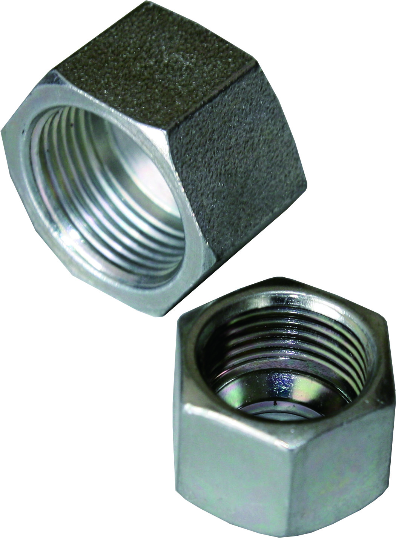
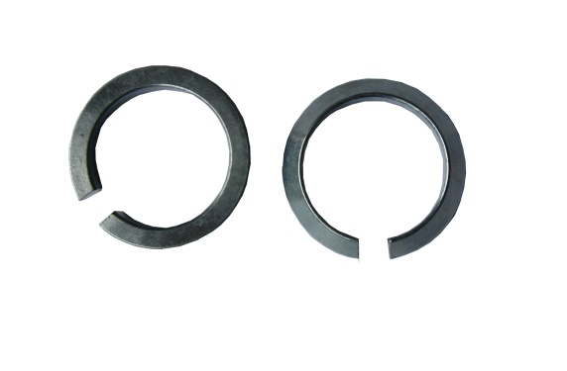
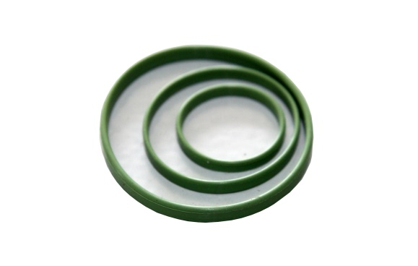
WMD Industrial Technology
1.6 Consumables
耗材
轻型：L8,L10,L12,L15,L18,L22,L28,L35,L42
重型：S8,S10,S12,S14,S16,S20,S25,S30,S38

Slide 36
WMD Industrial Technology
Seal Ring 密封圈
# | S/N | Item Name | Description
1 | R8 | 8 seal ring | Sealing ring for pipe of diameter @ 8mm
2 | R10 | 10 seal ring | Sealing ring for pipe of diameter @ 10mm
3 | R12 | 12 seal ring | Sealing ring for pipe of diameter @ 12mm
4 | R14 | 14 seal ring | Sealing ring for pipe of diameter @ 14mm
5 | R15 | 15 seal ring | Sealing ring for pipe of diameter @ 15mm
6 | R16 | 16 seal ring | Sealing ring for pipe of diameter @ 16mm
7 | R18 | 18 seal ring | Sealing ring for pipe of diameter @ 18mm
8 | R20 | 20 seal ring | Sealing ring for pipe of diameter @ 20mm
9 | R22 | 22 seal ring | Sealing ring for pipe of diameter @ 22mm
10 | R25 | 25 seal ring | Sealing ring for pipe of diameter @ 25mm
11 | R28 | 28 seal ring | Sealing ring for pipe of diameter @ 28mm
12 | R30 | 30 seal ring | Sealing ring for pipe of diameter @ 30mm
13 | R35 | 35 seal ring | Sealing ring for pipe of diameter @ 35mm
14 | R38 | 38 seal ring | Sealing ring for pipe of diameter @ 38mm
15 | R42 | 42 seal ring | Sealing ring for pipe of diameter @ 42mm

Slide 37

WMD Industrial Technology
C-Type Locked Ring C形锁紧环
Carben Steel （碳钢）
# | S/N | Item Name | Description
1 | L-L8 | 8 light C-type locked ring | Light C-type locked ring for pipe of diameter @ 8mm
2 | L-S8 | 8 Heavy C-type locked ring | Heavy C-type locked ring for pipe of diameter @ 8mm
3 | L-L10 | 10 light C-type locked ring | Light C-type locked ring for pipe of diameter @ 10mm
4 | L-S10 | 10 Heavy C-type locked ring | Heavy C-type locked ring for pipe of diameter @ 10mm
5 | L-L12 | 12 light C-type locked ring | Light C-type locked ring for pipe of diameter @ 12mm
6 | L-S12 | 12 Heavy C-type locked ring | Heavy C-type locked ring for pipe of diameter @ 12mm
7 | L-S14 | 14 Heavy C-type locked ring | Light C-type locked ring for pipe of diameter @ 14mm
8 | L-L15 | 15 light C-type locked ring | Heavy C-type locked ring for pipe of diameter @ 15mm
9 | L-S16 | 16 Heavy C-type locked ring | Light C-type locked ring for pipe of diameter @ 16mm
10 | L-L18 | 18 light C-type locked ring | Heavy C-type locked ring for pipe of diameter @ 18mm
11 | L-S20 | 20 Heavy C-type locked ring | Heavy C-type locked ring for pipe of diameter @ 20mm
12 | L-L22 | 22 light C-type locked ring | Light C-type locked ring for pipe of diameter @ 22mm
13 | L-S25 | 25 Heavy C-type locked ring | Heavy C-type locked ring for pipe of diameter @ 25mm
14 | L-L28 | 28 light C-type locked ring | Light C-type locked ring for pipe of diameter @ 28mm
15 | L-S30 | 30 Heavy C-type locked ring | Heavy C-type locked ring for pipe of diameter @ 30mm
16 | L-L35 | 35 light C-type locked ring | Light C-type locked ring for pipe of diameter @ 35mm
17 | L-S38 | 38 Heavy C-type locked ring | Heavy C-type locked ring for pipe of diameter @ 38mm
18 | L-L42 | 42 light C-type locked ring | Light C-type locked ring for pipe of diameter @ 42mm

Slide 38
WMD Industrial Technology
C-Type Locked Ring C形锁紧环
Stainless steel（不锈钢）
# | S/N | Item Name | Description
1 | L-L8-s | 8 light C-type locked ring | Light C-type locked ring for pipe of diameter @ 8mm
2 | L-S8-s | 8 Heavy C-type locked ring | Heavy C-type locked ring for pipe of diameter @ 8mm
3 | L-L10-s | 10 light C-type locked ring | Light C-type locked ring for pipe of diameter @ 10mm
4 | L-S10-s | 10 Heavy C-type locked ring | Heavy C-type locked ring for pipe of diameter @ 10mm
5 | L-L12-s | 12 light C-type locked ring | Light C-type locked ring for pipe of diameter @ 12mm
6 | L-S12-s | 12 Heavy C-type locked ring | Heavy C-type locked ring for pipe of diameter @ 12mm
7 | L-S14-s | 14 Heavy C-type locked ring | Light C-type locked ring for pipe of diameter @ 14mm
8 | L-L15-s | 15 light C-type locked ring | Heavy C-type locked ring for pipe of diameter @ 15mm
9 | L-S16-s | 16 Heavy C-type locked ring | Light C-type locked ring for pipe of diameter @ 16mm
10 | L-L18-s | 18 light C-type locked ring | Heavy C-type locked ring for pipe of diameter @ 18mm
11 | L-S20-s | 20 Heavy C-type locked ring | Heavy C-type locked ring for pipe of diameter @ 20mm
12 | L-L22-s | 22 light C-type locked ring | Light C-type locked ring for pipe of diameter @ 22mm
13 | L-S25-s | 25 Heavy C-type locked ring | Heavy C-type locked ring for pipe of diameter @ 25mm
14 | L-L28-s | 28 light C-type locked ring | Light C-type locked ring for pipe of diameter @ 28mm
15 | L-S30-s | 30 Heavy C-type locked ring | Heavy C-type locked ring for pipe of diameter @ 30mm
16 | L-L35-s | 35 light C-type locked ring | Light C-type locked ring for pipe of diameter @ 35mm
17 | L-S38-s | 38 Heavy C-type locked ring | Heavy C-type locked ring for pipe of diameter @ 38mm
18 | L-L42-s | 42 light C-type locked ring | Light C-type locked ring for pipe of diameter @ 42mm

Slide 39
WMD Industrial Technology
SQR nut 功能螺母
# | S/N | Item Name | Description
1 | N-L8 | L8 nut | nut for light type of pipe of diameter @ 8mm
2 | N-S8 | S8 nut | nut for heavy type of pipe of diameter @ 8mm
3 | N-L10 | L10 nut | nut for light type of pipe of diameter @ 10mm
4 | N-S10 | S10 nut | nut for heavy type of pipe of diameter @ 10mm
5 | N-L12 | L12 nut | nut for light type of pipe of diameter @ 12mm
6 | N-S12 | S12 nut | nut for heavy type of pipe of diameter @ 12mm
7 | N-S14 | S14 nut | nut for heavy type of pipe of diameter @ 14mm
8 | N-L15 | L15 nut | nut for light type of pipe of diameter @ 15mm
9 | N-S16 | S16 nut | nut for heavy type of pipe of diameter @ 16mm
10 | N-L18 | L18 nut | nut for light type of pipe of diameter @ 18mm
11 | N-S20 | S20 nut | nut for heavy type of pipe of diameter @ 20mm
12 | N-L22 | L22 nut | nut for light type of pipe of diameter @ 22mm
13 | N-S25 | S25 nut | nut for heavy type of pipe of diameter @ 25mm
14 | N-L28 | L28 nut | nut for light type of pipe of diameter @ 28mm
15 | N-S30 | S30 nut | nut for heavy type of pipe of diameter @ 30mm
16 | N-L35 | L35 nut | nut for light type of pipe of diameter @ 35mm
17 | N-S38 | S38 nut | nut for heavy type of pipe of diameter @ 38mm
18 | N-L42 | L42 nut | nut for light type of pipe of diameter @ 42mm

Slide 40
WMD Industrial Technology
谢谢！
联系电话：13774668446
Email: service@wmdtech.cn
Web: www.wmdtech.cn

